Slide 1

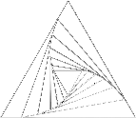

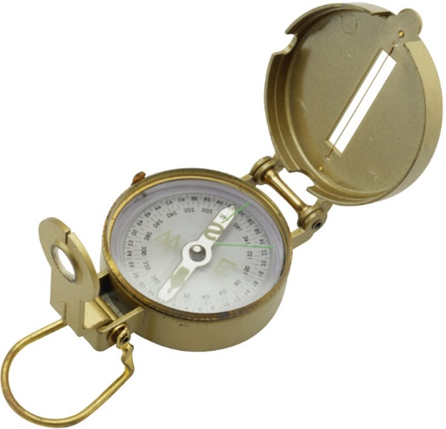
User / Training Manual
TM
Using Decision Support Sciences’ Dynamic Market Positioning Tool, PositionSolveTM for Perceptual Mapping and Marketing Strategy Development
Decision Support Sciences. Better Science. Better Solutions.

Slide 2
All contents Copyright © 2015 by Decision Support Sciences
PositionSolveTM, ProductSolveTM, SatisfactionSolveTM, CRMSolveTM, SegmentSolveTM and InnovationSolveTM are trademarks of Decision Support Sciences (DSS).
No portion of this work may be reproduced in any form without the written consent of Decision Support Sciences.
For permissions or other questions, contact DSS at info@decisionsupportsciences.com.

Slide 3
Table of Contents
I. Installing PositionSolveTM
System Requirements
Installation Procedure
II. Overview of PositionSolveTM
What Is Position Analysis
Why Use Multiple Discriminant Analysis (MDA)?
Why Use Correspondence Analysis (CA)?
Introduction To PositionSolveTM Perceptual Maps
III. Building a Perceptual Map
Type of Data Required for MDA and CA based mapsTM
Using the PositionSolve™ Model Wizard
To Build a MDA Based Perceptual Map
To Build a CA Based Perceptual Map
Saving the Map
IV. Inspecting Product and Attribute Relationships
Significant Distance Between Products
Closest Competitor Analysis
Respondent Mapping or Category Contouring
Attribute Elasticity
Map Options
V. Product Contouring
(Only with MDA)
Theory
Practice
Product Repositioning
(Only with MDA)
Theory
Practice
VII. Appendix
Dialog Boxes
Using Charts/Graphs
Personalities

Slide 4
System Requirements
PositionSolveTM can be run on any Intel Core Processor (first generation or greater) running any 64bit version of Windows 7 or higher. It is recommended that you have 1GB RAM, 256 MB of graphics RAM, and at least 500 MB of free hard disk space.
Installing PositionSolveTM
Whether you are installing from a CD or from a downloaded executable file, you will run the file setup.exe. Follow the instructions on the screen for installation.
During installation, you may choose in which directory PositionSolveTM is installed, and where the shortcut is accessed from the Start menu.
PositionSolveTM requires either an SPSS SAV file or and Excel file containing, at minimum, a set of variables (typically arranged in columns) and a set of respondent data (typically arranged in rows.)

Slide 5
II. Overview of PositionSolveTM
What Is Positioning Analysis?
Why Use Multiple Discriminant Analysis?
Why Use Correspondence Analysis?
Why Use Principle Components Analysis or Factor Analysis?
Introduction To PositionSolve^{TM’s} Perceptual Maps

Slide 6
What is Positioning Analysis?
Overview of PositionSolveTM
Positioning analysis is the process of determining the position of an object (usually a product or service offering in the market) relative to its competitors. In marketing application a positioning analysis starts by asking respondents to rate, rank, or pick a set of characteristics that they believe represent a given product or service offering. Across dozens or even thousands of respondents this yields enough data to allow the various objects under study to be mathematically positioned relative to one another. This produces what is often termed a perceptual map; a 3-D projection of the relationship of the various objects to one another against a background of the features or characteristics of those objects.
Positioning analysis is often used by marketers to determine 1) the closest competitors to a given product offering 2) the attributes that most characterize a given product in the global “mind” of the market and 3) what specific changes would be most effective in changing a product’s position and capturing market share.
PositionSolveTM is a “multi-algorithm” positioning system which currently uses discriminant analysis, correspondence analysis, and principal components analysis to produce its positioning analyses.* The primary outcome of positioning analysis is the production of a positioning map (which is also called a perceptual or strategy map). The central advantage of these “maps” are that they are uniquely powerful in representing a large amount of information in a very concise way. The power of positioning analysis is that regardless of whether the underlying mathematics is discriminant, correspondence or principle components, each of these techniques performs data reduction. In data reduction the “math” extracts from the data the most important details such that the 3-D map represents the maximal amount of information “compressed” into the first three “mappable” dimensions.
*factor analysis, multi-dimensional scaling, and ALSOS techniques are in development.

Slide 7
Why Use Multiple Discriminant Analysis (MDA)?
Overview of PositionSolveTM
Multiple Discriminant Analysis (MDA) is the an excellent choice for positioning analysis for a number of reasons:
In marketing it is quite typical for research studies to collect the features of a product or service on a importance or performance scale (e.g. a 1-7 Likert scale.) MDA expects such scaled data.
MDA is familiar to most social scientists as the premier general linear model technique used for classification analysis.
2) MDA (along with factor analysis) is an implementation of the general linear model. Techniques based on the general linear model can be intuitively and more easily extended to performing dynamic analysis. (Dynamic analyses allow simulation, movement, and repositioning on a perceptual map.) In the general linear model, the attributes or characteristics of the market (such as wattage of a microwave oven) serve as predictors of the positioning of the products themselves. Consequently, as you would expect, when the attributes of a given product are changed, the product “moves,” changing the structure of the space that underlies the perceptual map.
3) MDA is the only data-reduction technique designed to produce the maximum separation among products. Since the products are usually the primary points of interest on the map, MDA’s decision rule to represent the underlying structure of the data with explicit respect to the products is useful. Conversely, in factor analysis, the focus is solely on the the attributes themselves. With factor analysis, the products are located as a function of the derived contribution of each attribute to each mapped dimension, but the resulting interproduct distances are not maximal. In discriminant analysis, however, the dimensions of the map are based on maximizing variation among products and minimizing variation within products. Consequently, MDA produces a perceptual map that maximizes interproduct distance.
4) In the default (MDA) implementation of PostionSolveTM, the lengths of the attribute lines, or arrows, represent the direction in which maximum differentiation among competitors can be achieved. Most product managers are vitally concerned with finding a unique market niche for their product, maximally differentiating it from the other products in the competitive set. In PositionSolveTM, by moving a product in the direction of the endpoints of the longest attributes, you are moving it toward maximal differentiation on those attributes.

Slide 8
Why Multiple Discriminant Analysis (MDA)? (con’t)
Overview of PositionSolveTM
5) MDA can tell you which attributes are important in the underlying market space, and which you can ignore. Because discriminant analysis is capable of proceeding stepwise, it automatically discards attributes that do not contribute significantly to the solution.
6) Because of its decision rule, when MDA-based perceptual mapping is combined with importance data, the resulting maps represent both differentiation and importance parsimoniously. Every brand manager recognizes that good strategies are produced only when you are making changes to a product attribute that is both important and in which there is competitive differentiation. As mentioned above, MDA-based perceptual maps, especially stepwise ones, include only those attributes that have strong interproduct differentiation. Thus, if the underlying data are importance-based (such as preference data from conjoint analysis), the derived perceptual map maximally separates products based on importance data. The strategic power of this approach is that it combines both importance (via the data source) and difference (via the MDA decision rule) on the same map. This use of perceptual mapping is also called preference mapping.

Slide 9
Why Use Correspondence Analysis (CA)?
Overview of PositionSolveTM
Correspondence Analysis (CA) is another excellent choice for positioning analysis for a number of reasons:
In marketing it is quite typical for research studies to collect the features of a product or service using “pick-any” data. In “pick-any” data the respondent is asked to pick a set of features that characterize a given product. CA expects such categorical or “pick-any” data.
CA is familiar to most social scientists as the premier categorical data technique used for perceptual mapping.
2) Quite often CA produces maps that compress more information in the lower dimensions. That is, when the numbers of products and attributes are large, CA is the method of choice to obtain maps that express the maximum amount of information in the fewest number of dimensions.
3) CA’s ability to compress more information in smaller number of dimensions make it appropriate for building systems where demand is placed on the perceptual space. Placing demand on the perceptual space was introduced by DSS in 2004 at the AMA’s Annual Advanced Research Technique Forum.
CA’s ability to place demand on the perceptual space allows strategists to move a given direction for a reason…because market opportunity is there.
CA’s ability to place demand on the makes it possible to create a demand simulator. This is indeed the innovation we developed in 2004-2005, and it form the core of InnovationSolveTM our decision support platform enhancement to PositionSolveTM. The demand simulation and other feature specific to InnovationSolveTM will be presented in InnovationSolveTM’s user manual..

Slide 10
Why Principle Components Analysis?
Overview of PositionSolveTM
Principle Components Analysis (PCA) is the earliest and up until the 1970’s was the most popular choice for positioning analysis. While PCA and Factor Analysis (a technique based on the same input data but based on a more formal statistical model) have been generally superceded by MDA for the reasons given on pages 6-7, PCA or FA are still an indicated technique for positioning analysis under a number of conditions:
When research studies collect characteristics of the market rather than characteristics of a given product PCA or FA is indicated. For example, these might include studies in which a respondent is asked to rate features that are important to them when considering a new purchase. In this kind of study we only have market level data (what is important to them) but we do NOT have data at the level of an individual product.
When research studies attempt to correlate performance on a set of key factors to some overall measure of satisfaction. In this case a correlation matrix between the factors themselves can be calculated which leads to the development of a positioning map. The products or companies that the respondent was rating can be placed on this space after the fact.
In both the above cases, the map is produced solely from the features being rated or scored.
Some comparisons and contrast between PCA and MCA should be made at this juncture.
PCA thus allows the production of a positioning map that allows the placement of both products and features on a positioning map when only feature level data is available. MCA on the other hand requires that a specific product is rated.
Because of the above, PCA’s positioning maps cannot and does not maximize the difference between objects (products or competitors being rated) as do MDA’s positioning maps. Otherwise, PCA or FA allows all the analytical features of MDA maps.

Slide 11
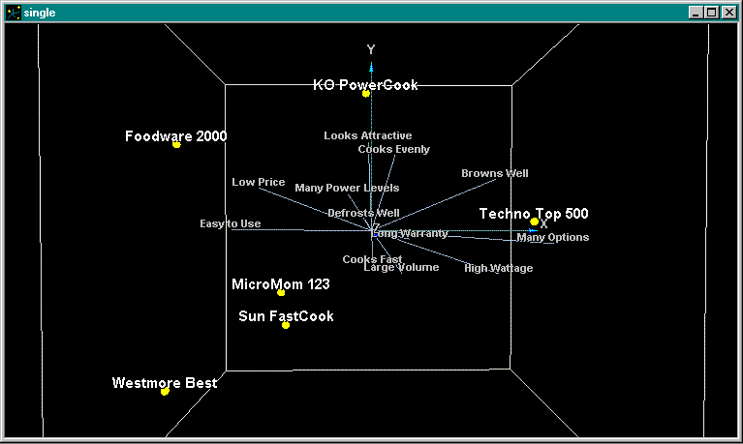
Introduction: Basic Interpretation of a Perceptual Map
Overview of PositionSolveTM
Feature Description
  Assuming that there is enough data, by default, PositionSolveTM plots the first three dimensions of the mapping space (which is technically called an N-space). As you may be aware, for all eigen-system based approaches to producing reduced space maps (which include MDA, CA, and PCA) the first dimension accounts for the most information, the second dimension the second most, and so on. The first second and third dimensions, by convention, are plotted on the X,Y, and Z dimensions respectively.
  As a result, when maps are adjusted by dimensional variance, if you rotate* the map so that you are looking down the third (Z) axis, there will be a relatively small amount of deviation of products and attributes from that axis. In contrast, there will be a larger deviation on the Y axis, and a larger deviation still on the X axis.
  The products are represented (again by default) as spheres.
  The attributes are represented (again by default) as lines connected from the origin to the position of that attribute’s actual location. Attributes that point in the same direction are positively correlated/associated. Attributes that point in opposite directions are uncorrelated. The length of the attribute relates to the contribution it make in creating the map.
Positioning
  The products are mathematically located on the map based on their relative scores on the attributes in the study. If a product ends up close to the center of the space, it is because it is generally undifferentiated on the attributes. In fact a product that score the market average on all attributes will sit at the origin (the exact center) of the space.
  Products that are perceived to be similar in performance are close to one another. Dissimilar products are lie far away from one another. All else being equal, a product close to the end of an attribute is well-differentiated on that attribute.
  For example, in this example the Foodware 2000 microwave is closest to the Low Price and Easy to Use attributes, so consumer perceive these to characterize that product.
*See the Graphs and Charts section of the appendix for a full explanation of Graph rotation capabilities.

Slide 12
III. Building a Perceptual Map
Types of Data Required for MDA and CA-Based Maps
Using the PositionSolve™ Model Wizard
To Build a MDA Based Perceptual Map
To Build a CA Based Perceptual Map
To Build a PCA Based Perceptual Map
Saving the Map

Slide 13
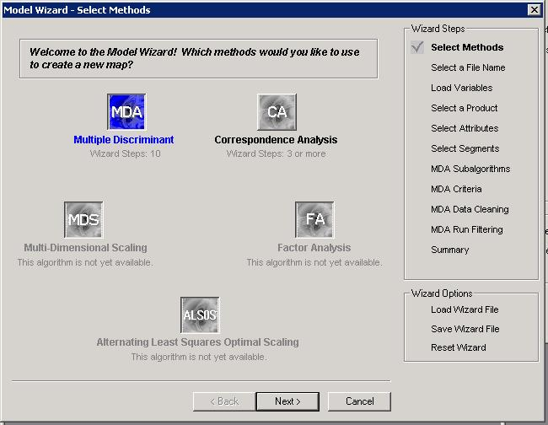
Using the PositionSolve™ Model Wizard to Build a MDA-Based Perceptual Map
Building a Perceptual Map
Step 1
  The dialog box displayed here is the first step in the ‘Build Model Wizard’.
  There are 5 methods that can be used to build a new PositionSolveTM map. The options available in the wizard at the current time are MDA, CA and PCA.
  All of the steps in the model wizard are displayed in the ‘Wizard Steps’ box on the right side of the dialog box. You may jump to any step at any time by clicking on the steps in this box.
  All of the selected options may also be saved in a wizard file from this dialog box. If you have a saved wizard file, the options can be loaded by clicking on the ’Load Wizard File’ option.

Slide 14
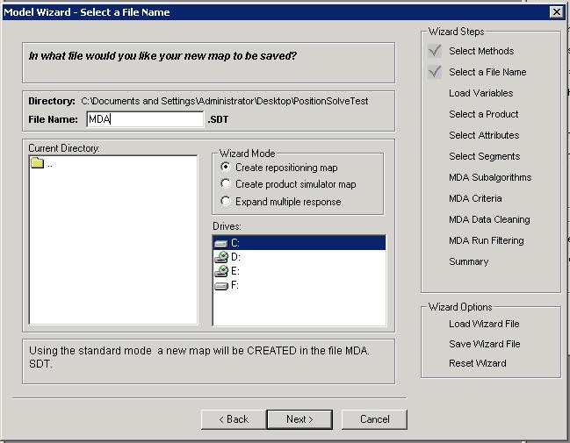
Using the PositionSolve™ Model Wizard to Build an MDA-Based Perceptual Map
Building a Perceptual Map
Step 2 – Select a File Name
  There are two options for creating a map using the wizard: you may ADD to an existing map or CREATE a new map.
  If an SDT file has already been created, it will show up in the left list box. To add to the file, highlight the file in the box.
  To create a new map, click on the file name text box, then type a descriptive root file name. Both the map and the wizard file (PWZ) will use this root file name.
  The directory location for the where the map and wizard file is listed above the text box. To change the default location for both the map and wizard files, click on the drive and directory window and navigate to any desired location on your local computer.
  Make sure that the description at the bottom of the dialog box is accurate concerning the add/create mode and the file name and directory.

Slide 15
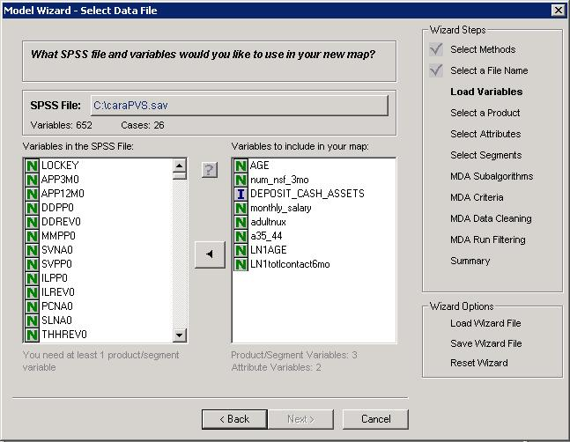
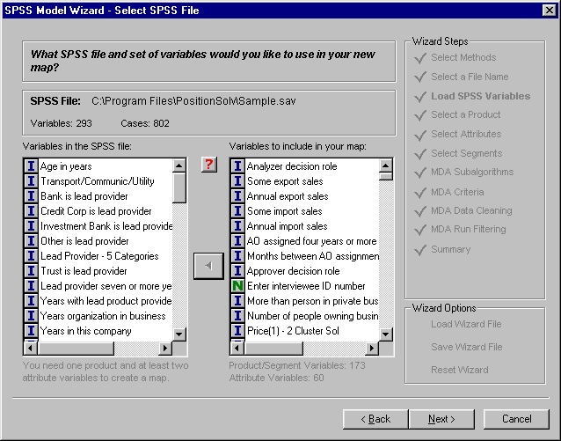
Using the PositionSolve™ Model Wizard to Build an MDA-Based Perceptual Map
Building a Perceptual Map
Step 3 – Select the SPSS file
  If your data is in an Excel file, convert that data to an SPSS SAV file format. See the appendix for how to do this.
  Click in the box labeled ‘SPSS file’ to select the data file used for the PositionSolveTM map file.
  The SPSS data file must contain attributes and at least one variable to use as a product. Your file may also contain categorical variables you may chose to use as segments.
  When the file is selected, the available variables appear in the left list box. The symbol to the left of each variable name denotes the variable type. There are four variable types:
    N=Nominal variables. Any variable that can be asked as a yes/no question would fit this category
    O=Ordinal variables. Questions where the respondent is asked to define a rank order for several items are ordinal.
    I=interval scaled variable, which when asked in an interview, usually requires a text entry answer. This is a continuous variable.
    R=ratio scaled variable, which is very similar to interval scaled, but it has a unique rather than an arbitrary zero point. Ratio scaled variables are also continuous.
  Highlight the variables you need to build your map in the left list box, then click on the arrow in the middle to transfer them to the box of selected variables.
  To see the variable labels instead of the SPSS variable name, click on the in the middle of the dialog box, or use the options button (right mouse button) on your pointing device to see other options.

Slide 16
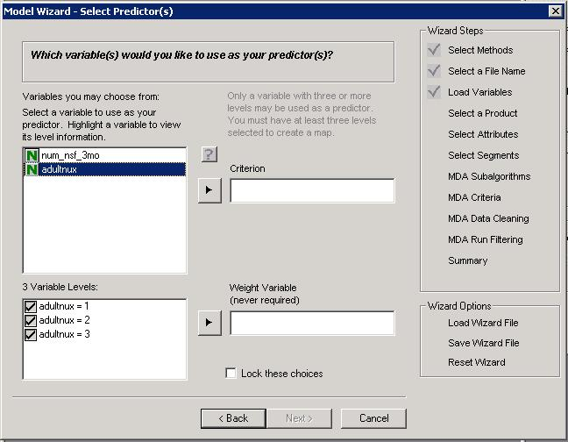
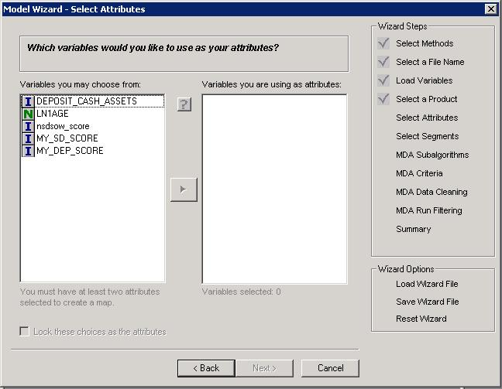
Using the PositionSolve™ Model Wizard to Build an MDA-Based Perceptual Map
Building a Perceptual Map
Step 4 – Select the Product Variable
  Select the categorical variable that contains the names of the competitors, product or services that you measured in the study.
  Do this by clicking on the variable in the left box. The levels for that variable will be displayed in the level box directly below the variable selection box. Then click on the arrow to the left of the Criterion box to add that variable as your criterion variable.
Step 5 – Select the Weight Field
  If you have respondent weights in your data file, and you want your resultant positioning maps to reflect that weighting add the weight variable to the weight variable field just as you did with the Criterion field.
Step 6 – Select Attributes
  Attributes to be included in the map are selected the same way that the variables were originally selected. Highlight the variables in the left box, then click on the arrow in the middle to transfer them to the box of included variables.
  At least two attribute variables must be included in the map.
  If the ‘Lock these choices as attributes’ option is selected, the attribute choices may not be changed after the map is created.

Slide 17
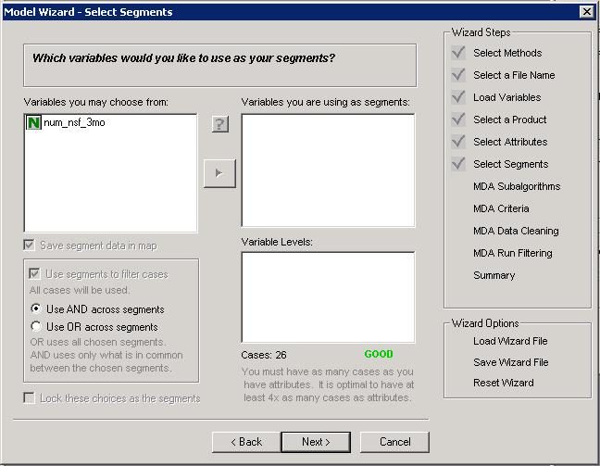
Using the PositionSolve™ Model Wizard to Build an MDA-Based Perceptual Map
Building a Perceptual Map
Step 7 – Select Segments
  Segments of the data can be selected for specific analysis by selecting segment variables at this step. You can exclude a portion of the cases in your segment by deselecting levels in the ‘variable levels’ box.
  Notice that within the variable levels box, the total number of selected cases is shown, as well as a poor – excellent rating for that number of cases. This rating is a recommendation based on the number of cases required to create a map with acceptable degrees of freedom (statistical validity). It is recommended to not build CA maps if the number of cases is rated as “poor”.
  Segments do not have to be selected to create a map. To omit this option, simply press the next button.

Slide 18
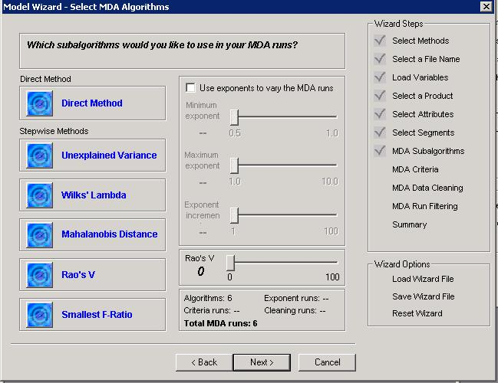
Using the PositionSolve™ Model Wizard to Build an MDA-Based Perceptual Map
Building a Perceptual Map
Step 8 – Select MDA Algorithms
  Click on the icon to the left of the method name to select the desired algorithm(s).
  To use exponents with the selected analysis methods, click on the exponent option and select the exponent restraints.
  ‘Exponent Increments’ refers to the number of different exponents that are used. If 10 increments are selected, the difference between the minimum and maximum exponent will be divided into 10 segments, and the exponent at each of those divisions will be used.
  For more on how exponents are used to transform the predictors, see the appendix.
  A summary of the selected algorithms and exponents is given in the box at the bottom.

Slide 19
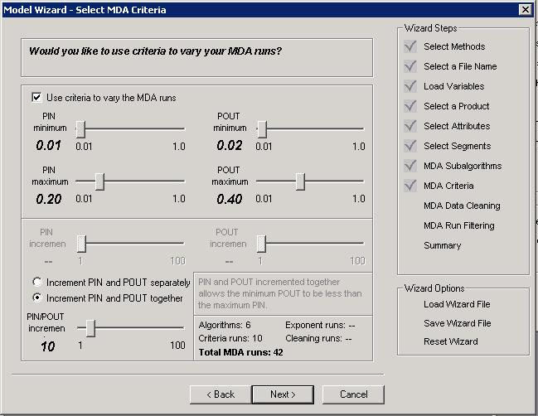
Using the PositionSolve™ Model Wizard to Build an MDA-Based Perceptual Map
Building a Perceptual Map
Step 9 – Select MDA Criteria
  If you want to use stepwise methods of discriminant analysis in creating your positioning map, check criteria the box.
  PIN and POUT refer to the required probability for a variable to be included or excluded from the stepwise methods of discriminant analysis.
  The top PIN and POUT increment options are available if the default option ‘Increment PIN and POUT separately’ option is selected. If the increment together option is selected, the scale at the bottom should be used.
  A summary of the selected algorithms, exponents, and criteria is given in the box at the bottom of this page. Notice that the total number of runs is equal to the criteria applied to the stepwise runs (unexplained variance, Wilk’s, Mahalanobis, and smallest F-ratio) plus one run for Rao’s V and the Direct method if selected.

Slide 20
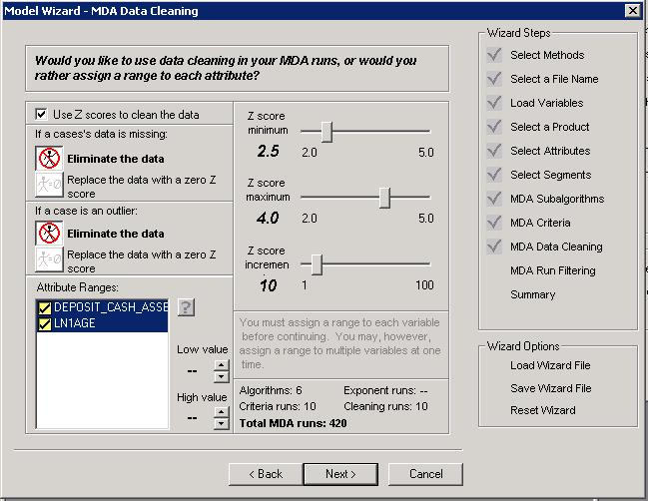
Using the PositionSolve™ Model Wizard to Build an MDA-Based Perceptual Map
Building a Perceptual Map
Step 10 –MDA Data Cleaning
  There are two methods for dealing with missing data eliminating that data or replacing that missing data with a Z Score of zero (effectively replacing it with the mean score.) The same two methods apply to replacing a value determined to be an outlier.
  If Z scores are being used, select the icons that represent how the data should be handled. PositionSolveTM will create several possible maps, excluding respondents with a z-score of an absolute value greater than the maximum. The minimum and maximum set here refer to the z-scores to be excluded. The number of Z score increments can significantly increase the number of total runs to create the map.
  If a range is being assigned to each variable, highlight one or more variables in the list box, then use the arrows to select the minimum and maximum acceptable values for the attribute. The variables that have a range will have a yellow checkmark by the variable name.
  A summary of the selected algorithms, exponents, and criteria is given in the box at the bottom. The total number of runs will give you an estimate of the analysis time to create the map.

Slide 21
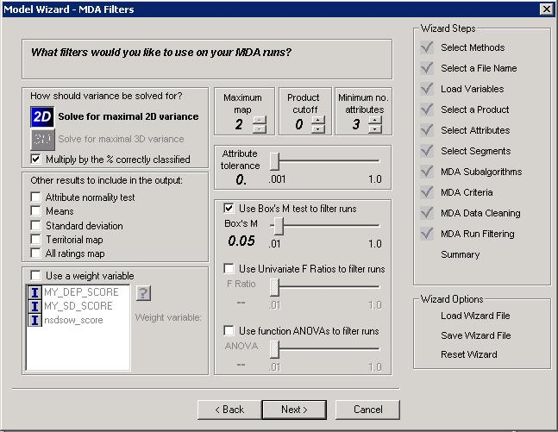
Using the PositionSolve™ Model Wizard to Build an MDA-Based Perceptual Map
Building a Perceptual Map
Step 10 –MDA Filters
  First select either 2D or 3D variance. Selecting this tells the application to select as its best map the map that compresses the most information in either 2 or 3 dimensions.
  Check the optional results to be included in the results. None of these output options are required for the basic positioning analysis options once the map is required, but they may be helpful in the preliminary analysis.
  If a weight variable is to be used, check the weight variable option, then highlight the variable name in the list box.
  Use the slider to change the attribute tolerance level. The attribute tolerance is the amount of dependence or similarity allowable between attributes. The default value is 0.001.
  There are three options for filtering the runs, and any combination of these methods, from none to all three, can be used to create the map.
  The product cutoff and the minimum number of attributes must be greater than 0 for a map to be created.

Slide 22
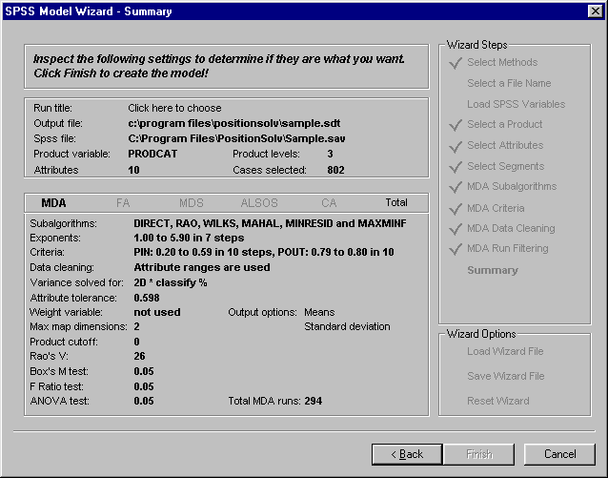
Using the PositionSolve™ Model Wizard to Build an MDA-Based Perceptual Map
Building a Perceptual Map
Step 11 –Summary
  This screen displays a summary of all the options that were selected for the current analysis run. Check the values here closely to ensure the options are set correctly. If an option is missing or incomplete, there will be an error message by the option name to let you know that it needs to be modified. You may either press the back key to make any changes, or you may click on the appropriate wizard step in the right panel to jump directly to that wizard page.
  A run title for the current map analysis must be entered on this screen. Click on the text to enter a title.
  The total number of required runs is listed at the bottom of the screen.
  When all of the options are complete and correct, select the ‘finish’ button at the bottom to begin the analysis.

Slide 23
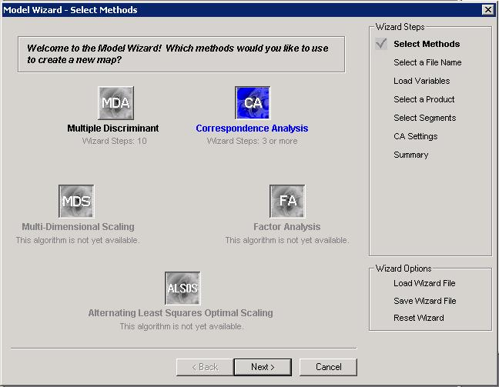
Using the PositionSolve™ Model Wizard to Build a CA-Based Perceptual Map
Building a Perceptual Map
Step 1
  The dialog box displayed here is the first step in the ‘Build Model Wizard’.
  There are currently 5 methods that can be used to build a new PositionSolveTM map. The options available in the wizard at the current time are MDA, CA and PCA.
  All of the steps in the model wizard are displayed in the ‘Wizard Steps’ box on the right side of the dialog box. You may jump to any step at any time by clicking on the steps in this box.
  All of the selected options may also be saved in a wizard file from this dialog box. If you have a saved wizard file, the options can be loaded by clicking on the ’Load Wizard File’ option.

Slide 24
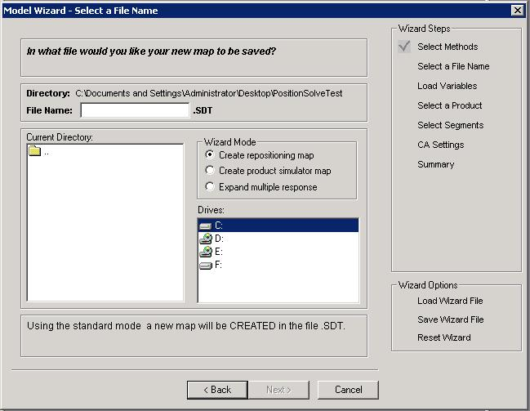
Using the PositionSolve™ Model Wizard to Build a CA-Based Perceptual Map
Building a Perceptual Map
Step 2 – Select a File Name
  There are two options for creating a map using the wizard: you may ADD to an existing map or CREATE a new map.
  If an SDT file has already been created, it will show up in the left list box. To add to the file, highlight the file in the box.
  To create a new map, click on the file name text box, then type a descriptive root file name. Both the map and the wizard file (PWZ) will use this root file name.
  The directory location for the where the map and wizard file is listed above the text box. To change the default location for both the map and wizard files, click on the drive and directory window and navigate to any desired location on your local computer.
  Make sure that the description at the bottom of the dialog box is accurate concerning the add/create mode and the file name and directory.

Slide 25
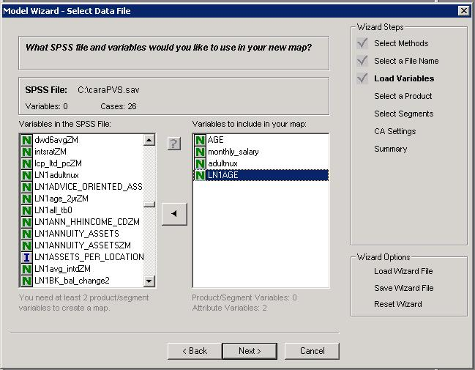
Using the PositionSolve™ Model Wizard to Build a CA-Based Perceptual Map
Building a Perceptual Map
Step 3 – Select the SPSS file
  If your data is in an Excel file, convert that data to an SPSS SAV file format. See the appendix for how to do this.
  Click in the box labeled ‘SPSS file’ to select the data file used for the PositionSolveTM map file.
  The SPSS data file must contain attributes and at least one variable to use as a product. Your file may also contain categorical variables you may chose to use as segments.
  When the file is selected, the available variables appear in the left list box. The symbol to the left of each variable name denotes the variable type. There are four variable types:
    N=Nominal variables. Any variable that can be asked as a yes/no question would fit this category
    O=Ordinal variables. Questions where the respondent is asked to define a rank order for several items are ordinal.
    I=interval scaled variable, which when asked in an interview, usually requires a text entry answer. This is a continuous variable.
    R=ratio scaled variable, which is very similar to interval scaled, but it has a unique rather than an arbitrary zero point. Ratio scaled variables are also continuous.
  Highlight the variables you need to build your map in the left list box, then click on the arrow in the middle to transfer them to the box of selected variables.
  To see the variable labels instead of the SPSS variable name, click on the in the middle of the dialog box, or use the options button (right mouse button) on your pointing device to see other options.

Slide 26
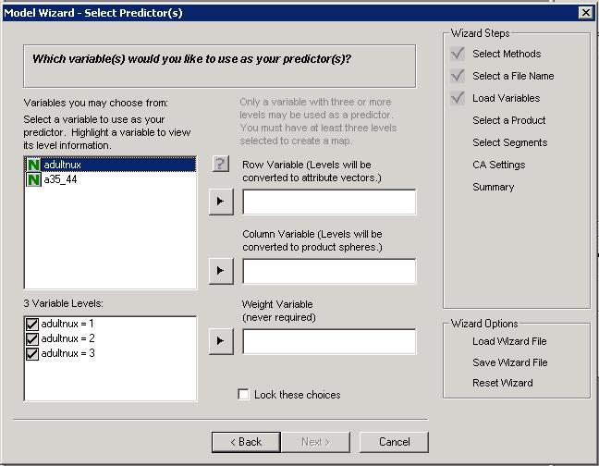
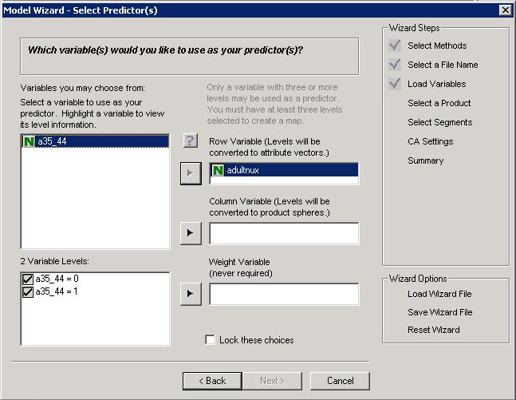
Using the PositionSolve™ Model Wizard to Build a CA-Based Perceptual Map
Building a Perceptual Map
Step 4 – Select a Row Variable
  In this dialog box, PositionSolveTM will list the possible variables that could be used as the row variable. In CA only categorical variables (variables with discrete levels) can be used as the row (product) or column (attribute) variables. When you use your pointing device to highlight a variable in the left box, the levels for that variable will be displayed in the level box on the right. Specific levels can be excluded from the analysis by deselecting that level with your pointing device.
Step 5 – Select a Column Variable
  The column variable that you will use as the attributes for your map are selected the same way that the row (product) variable was selected. Highlight the variable in the left box, then click on the arrow in the middle to select it for analysis.

Slide 27
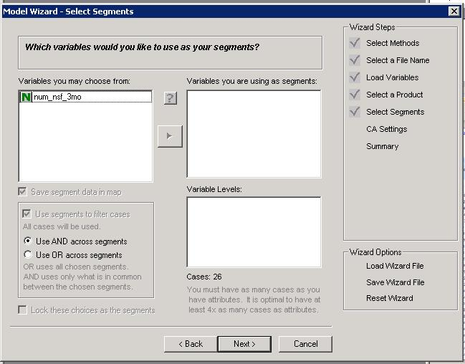
Using the PositionSolve™ Model Wizard to Build a CA-Based Perceptual Map
Building a Perceptual Map
Step 6 – Select Segments
  Segments of the data can be selected for specific analysis by selecting segment variables at this step. You can exclude a portion of the cases in your segment by deselecting levels in the ‘variable levels’ box.
  Notice that within the variable levels box, the total number of selected cases is shown, as well as a poor – excellent rating for that number of cases. This rating is a recommendation based on the number of cases required to create a map with acceptable degrees of freedom (statistical validity). It is recommended to not build CA maps if the number of cases is rated as “poor”.
  Segments do not have to be selected to create a map. To omit this option, simply press the next button.

Slide 28
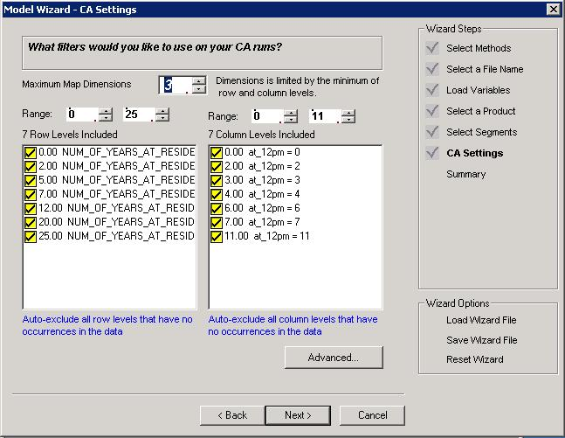
Using the PositionSolve™ Model Wizard to Build a CA-Based Perceptual Map
Building a Perceptual Map
Step 7 –CA Settings
  Select the number of dimensions desired. The minimum number of dimensions should normally be set to three. The maximum number of dimensions is one less than the number of rows or columns whichever is fewer.
  Adjust the included levels for both the row and column variable. These levels may be adjacent or non-adjacent.

Slide 29
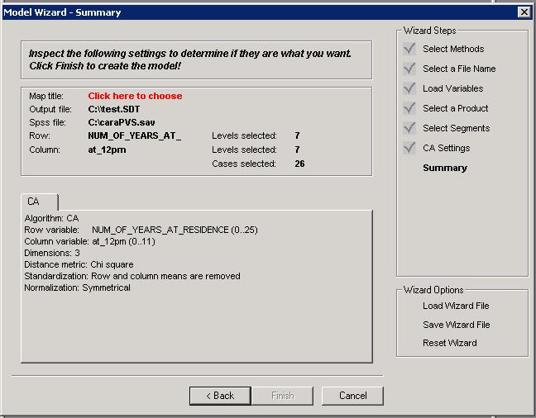
Using the PositionSolve™ Model Wizard to Build a CA-Based Perceptual Map
Building a Perceptual Map
Step 8 –Summary
  This screen displays a summary of all the options that were selected for the current analysis run. Check the values here closely to ensure the options are set correctly. If an option is missing or incomplete, there will be an error message by the option name to let you know that it needs to be modified. You may either press the back key to make any changes, or you may click on the appropriate wizard step in the right panel to jump directly to that wizard page.
  A run title for the current map analysis must be entered on this screen. Click on the text to enter a title.
  The total number of required runs is listed at the bottom of the screen.
  When all of the options are complete and correct, select the ‘finish’ button at the bottom to begin the analysis.

Slide 30
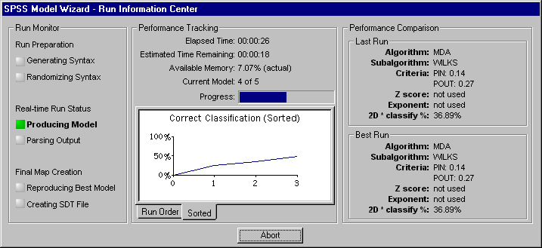
Using the PositionSolve™ Model Wizard
Building a Perceptual Map
Run Analysis
  PositionSolveTM uses two mathematical “engines” (sets of algorithms) to perform data reduction, SPSS-based algorithms and PositionSolveTM‘s own algorithms. (SPSS-based algorithms are only available if the user has purchased IBM-SPSS). This redundancy not only allows the application to provide quality assurance, but it is also provides a very useful “trade-off.” Specifically, while PositionSolveTM‘s algorithms are much faster (up to 100x) they are NOT designed to handle as many “off-nominal” data conditions, cases in which (for instance) the data is poorly conditioned for analysis, (such as when an input matrix is nearly collinear for example). In these cases SPSS will often complete the analysis and PositionSolve will not. In these kinds of cases, however, the user should be wary of its results.
Notice that:
  The Run Information Center dialog displays the current and best run detail, and tracks the time required for all runs.
  The performance tracking section shows the progress made and available memory on the computer being used for analysis.
  For MDA runs, the chart represents the percentage of information accounted for by the MDA model in the number of dimensions defined by the user.
  For CA runs, the chart represents represents the percent of inertia explained in three dimensions.

Slide 31
Introduction: Basic Interpretation of a Perceptual Map
Overview of PositionSolveTM
Feature Description
  Assuming that there is enough data, by default, PositionSolveTM plots the first three dimensions of the mapping space (which is technically called an N-space). As you may be aware, for all eigen-system based approaches to producing reduced space maps (which include MDA, CA, and PCA) the first dimension accounts for the most information, the second dimension the second most, and so on. The first second and third dimensions, by convention, are plotted on the X,Y, and Z dimensions respectively.
  As a result, when maps are adjusted by dimensional variance, if you rotate* the map so that you are looking down the third (Z) axis, there will be a relatively small amount of deviation of products and attributes from that axis. In contrast, there will be a larger deviation on the Y axis, and a larger deviation still on the X axis.
  The products are represented (again by default) as spheres.
  The attributes are represented (again by default) as lines connected from the origin to the position of that attribute’s actual location. Attributes that point in the same direction are positively correlated/associated. Attributes that point in opposite directions are uncorrelated. The length of the attribute relates to the contribution it make in creating the map.
Positioning
  The products are mathematically located on the map based on their relative scores on the attributes in the study. If a product ends up close to the center of the space, it is because it is generally undifferentiated on the attributes. In fact a product that score the market average on all attributes will sit at the origin (the exact center) of the space.
  Products that are perceived to be similar in performance are close to one another. Dissimilar products are lie far away from one another. All else being equal, a product close to the end of an attribute is well-differentiated on that attribute.
  For example, in this example the Foodware 2000 microwave is closest to the Low Price and Easy to Use attributes, so consumer perceive these to characterize that product.
*See the Graphs and Charts section of the appendix for a full explanation of Graph rotation capabilities.

Slide 32
IV. Inspecting Product and Attribute Relationships
Closest Competitor Analysis
Significant Distance Between Products
Respondent Mapping or Category Contouring
Attribute Elasticity
Map Options
Fly Through

Slide 33
Closest Competitor Analysis
Applicability: MDA, CA and PCA
Theory:
Perceptual Mapping is powerful because it is a data reduction technique. It condenses many dimensions of data down to just a few, enabling an analyst to inspect the closest competitors to his or her product. Yet, when we think about it, unless 100% of the data are represented in the first two map dimensions, two products that appear very close together may not be very close at all. That is, while they may appear to be close on both the horizontal (x) and vertical (y) axes, they may not be close together at all on the depth (z) axis. Thus, while the perceptual map doesn’t “lie”, it may not reveal all of its “secrets” in the first two or three dimensions. How can we really tell, then, who are our closest competitors?
A far better approach is to calculate a distance between each of the products and every other product. This can be done using any number of distance metrics (Chi-square, Mahalanobis, etc.). But let’s simplify a bit here. Applying the time-honored Euclidean distance formula to the distances between dimensionally adjusted products has two advantages. First, it can account for all dimensions beyond the three that we “see.” This is quite important since it is not unusual in marketing data to have a map with, say, 10 dimensions. By applying closest competitor analysis, we account for all of the dimensions. This let’s us “see” which products are really closest together. Second, it allows us to compare that real distance to the date reduced space projected in the lowest dimensions (our positioning map). When there a big differences we should explore why.
With this as the “theory” as our backdrop, let’s see now explore how closest competitor analysis works in practice.

Slide 34
Example 1: Which Products Are Closest Within the Market?
Closest Competitor Analysis: Practice
Closest Competitor Analysis: Practice
Question:
  What are the closest competitors in the marketplace?
  Which of these competitors are significantly different from one another?
Input Data:
  Importance or performance data for each competitor collected on a scale
Steps:
  Open PositionSolveTM
  Open the desired data file. This will be a file names with the .SDT extension.
  Select the map desired. (SDT files can have many maps.)
  Select Closest Competitor analysis from the command center
  Set the option desired on Closest Competitor analysis (see the next page.)
  Run the Closest Competitor analysis (see the next page.)
Results:
  A visual display of products that are closest together.
  A optional report of product distances that are statistically significant

Slide 35
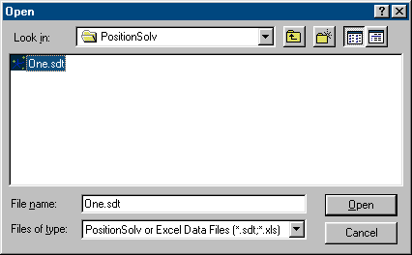
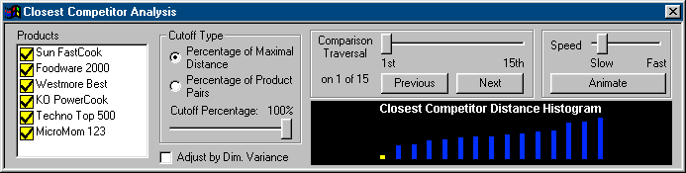
Example 1: Which Products are Closest Within the Market?
Closest Competitor Analysis: Practice
Open Data File
  Select Open from the File menu. Select your desired mapping file. It will have an .sdt file extension.
  Select that file and choose Open.
Open Closest Competitor Analysis
  Open the Command Center by clicking on the Command Center from the View Menu. Select the icon labeled Closest Competitor Analysis (CCA). Alternatively, select CCA from the Inspect main menu.
Analysis Options
  Products: Use your pointing device to select or deselect any number of products from the products box
  Cutoff Type: The analysis stops when you exceed the cutoff percentage selected on the Cutoff Percentage slider. If the “Percentage of Maximal Distance” type is selected (and the cutoff is 50%), the analysis stops once the distance between the next two products exceeds 50% of the distance from the products that are farthest apart. If the “Percentage of Product Pairs” option is selected, the top 50% of the competitors are plotted.
  Adjust by Dimension Variance: Since the amount of information contained in each successive dimension drops, PositionSolveTM ensures that the scaling of the axes of the map will be proportional to the variance in each dimension.
  The number of analyses made is determined by the number of products selected and the cutoff percentage. The total number is displayed in the Comparison Traversal Box or the Distance Histogram.

Slide 36
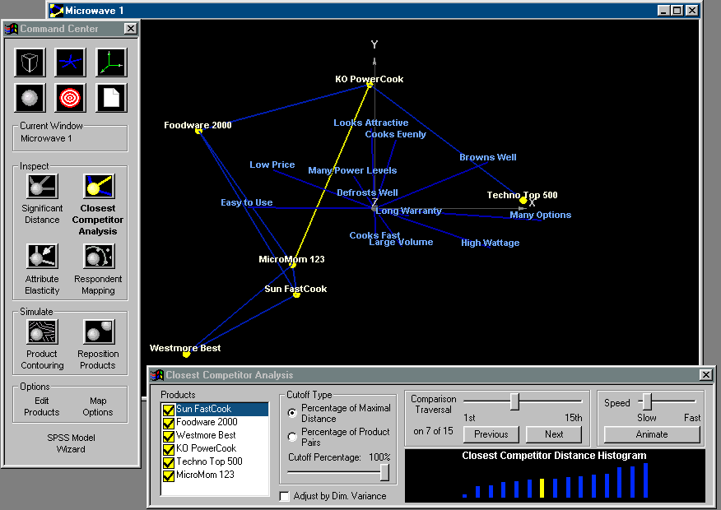
Example 1: Which Products Are Closest Within the Market?
Closest Competitor Analysis: Practice
Visualizing the Analysis
  You can either step through the visualization of each competitor distance manually, or let PositionSolveTM animate each distance and position for each product pair.
  To step through the analysis manually, select the Previous or Next buttons below the Comparison Traversal slider to see each product pair. The distance is rotated to lie on the plane of the screen so that the distance being represented in the three map dimensions is true.
  A bold yellow line denotes the current distance being displayed, and other connections are visible in the secondary color (default: blue).
  The model displays the relationships in order from the closest competitors across all dimensions to the farthest.
  The current product pair being displayed is highlighted in the Closest Competitor Distance Histogram diagram by the yellow bar.
  If the animation feature is selected, adjust the animate speed by moving the slider, then select the Animate button.

Slide 37
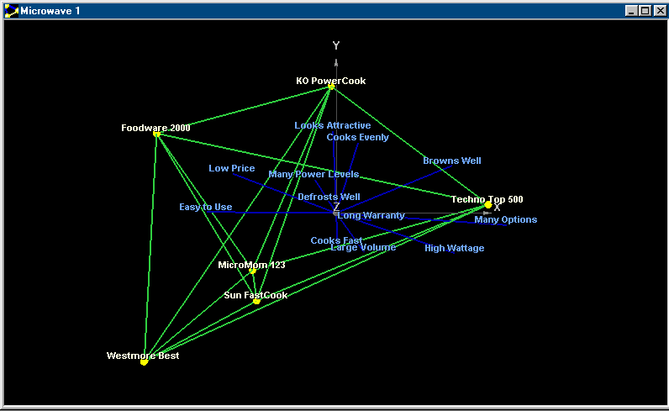
Significant Product Distance
Significant Product Distances
Applicability: MDA, CA, PCA
Theory
  The purpose of this ancillary analysis to Closest Competitor analysis is to show which products in the total N-dimensional space (all dimensions) are statistically separated from one another. This is more challenging than it first appears. A significant distance cannot be obtained merely by inspecting the distances between centroids (spheres) on the perceptual map because statistical separation is a function of both the distance and the variance around each product. (The greater the variance, or inconsistency of respondent ratings, the less the distinction.) That is, we need to recall that each product is the center of a “cloud” of respondents that rated it. If the cloud around each product is tightly localized, the distance necessary for that product centroid to be statistically different from another product centroid will be smaller.
  This distance is calculated using the Mahalanobis distance between products. The product significant distance analysis is available only when the indirect methods of discriminant analysis are used to build the model.
Determine Significant Product Distances
  Under the Inspect menu, select Product Significant Distance, or choose the Significant Distance icon from the command center.
  The product distances that are statistically significant will have a line connecting the two products. In this example all of the products are significantly distant from each other.
  Select the Display Attributes option to visualize the attribute positions in addition to the product distances.

Slide 38
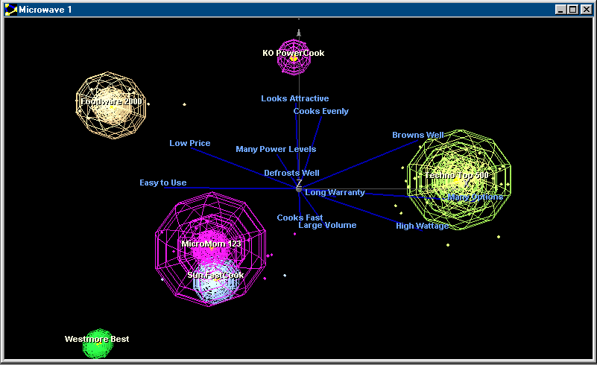
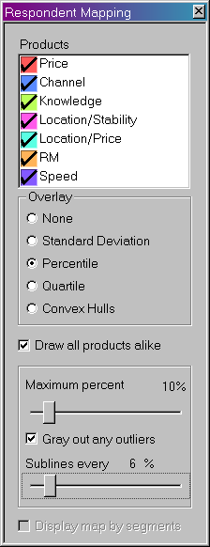
Brand Image Diffusion Analysis (Respondent Mapping)
Respondent Mapping: Theory and Practice
Applicability: MDA, CA and PCA
Theory
  Brand Image Diffusion Analysis can greatly enhance your understanding of the perceptual space. The reasoning behind this statement is quite straightforward. Each product plotted on the map, is, as we stated before a centroid, the center of a cloud of respondents who rated that product. Stated mathematically, the product is the geometric mean of the individual respondent ratings for that product.
  If this cloud of respondents is tightly localized around the centroid, then the market perception of the product is relatively homogeneous— the respondents hold similar images of that product. Conversely, if the cloud is spread out, respondents share no strong, consistent image of that competitor.
BIDA/ Respondent Mapping
  Under the Inspect menu, select Respondent Mapping, or select the icon from the command center.
  Products: From the Respondent Mapping dialog box, select one or more products to be mapped.
  Overlay: Select an overlay option to display a circle on the respondent map enclosing a portion of the respondents. None performs no overlay. Standard Deviation overlays a circle on the map one standard deviation away from the product. Percentile overlays percentiles and Quartile overlays quartiles.
  If the Percentile option is selected, the Maximum Percent Enclosed and Sublines Every x Percent options will be available.

Slide 39
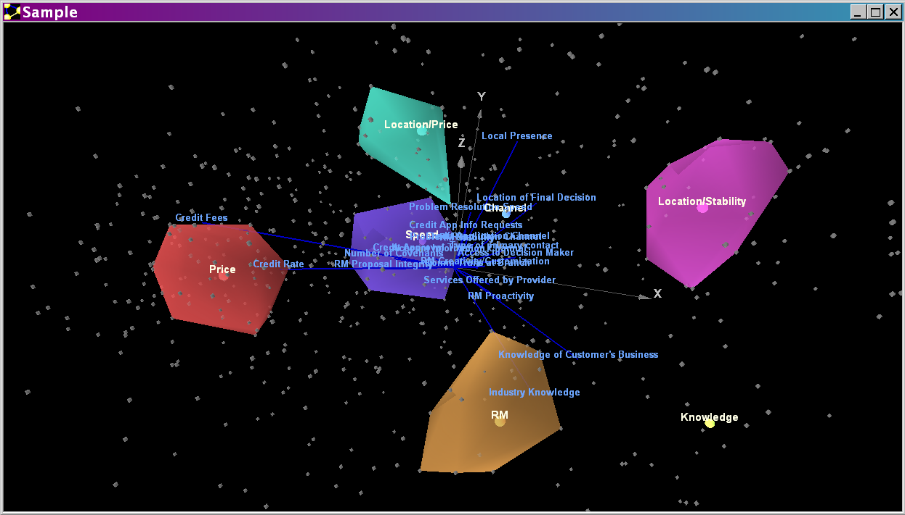
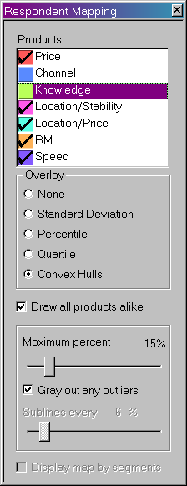
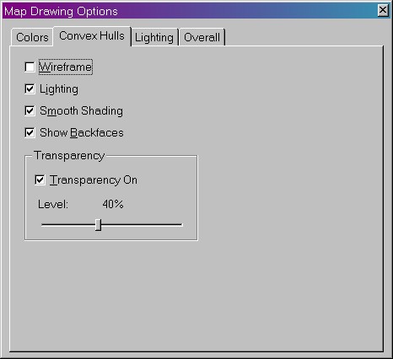
Contouring the Respondents in Brand Image Diffusion Analysis
Respondent Mapping: Theory and Practice
Convex Hulls
  Convex hulls are a mathematical way of “shrink wrapping” the respondents in Brand Image Diffusion Analysis.
  To use convex hulls, select the option in the overlay group box within the Respondent Mapping dialog box. Next, adjust the “maximum percent” slider to slew through the percentage of respondents allowed to contribute to the shape of each product.
  To elect not to show a product with a convex hull, deselect the product in the Respondent Mapping dialog.
  From the Options menu, select Drawing Options, then select the Convex Hulls tab to change visualization options for the convex hulls. The defaults are shown in the example dialog.

Slide 40
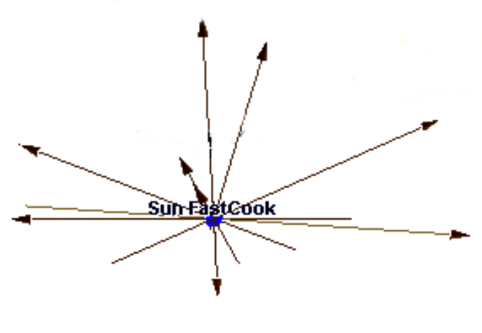
Attribute Elasticity
Attribute Elasticity: Theory and Practice
Applicability: MDA, CA and PCA
Theory
  Attribute elasticity illustrates how far and in what direction a product would move if you changed its rating on one attribute while keeping all the other attributes constant. Attribute elasticity is instructive for two reasons. First, it tells you something about that attribute itself. When you plot the attribute elasticity lines or vectors, for a particular product, the length of the lines differ. Elasticity lines are determined by the discrimination space itself. If an attribute does not do much to distinguish between products (it has a low F ratio), it contributes little to determining the discriminant space (at least in the dimensions being plotted). Since it doesn’t define the product space, it is short. A short line tells you that changing that product’s performance on that attribute won’t move it much on the map. Conversely, an attribute with a long attribute elasticity line indicates that the products are relatively different on that attribute. Because the attribute contributes much more to the calculation of the underlying space, changing its performance has greater potential to move the product on the map.
  Second, and perhaps more important from a practical perspective, attribute elasticity provides information that you can use when you want to manually reposition a product using a simulation feature. Attribute elasticity will clearly show you which attributes can change to move a product to a desired position on the map.
Interpreting Attribute Elasticity
  As this diagram demonstrates, a product’s position on any attribute can be modified positively or negatively. The attribute continuum goes through the product centroid, but does not originate at the center. The end of the attribute line without the arrowhead represents where the product would be centered if the position of that attribute were decreased as far as possible. Conversely, the end of the attribute line with the arrowhead represents where the product would be centered if the affect of that attribute were increased as far as possible.

Slide 41
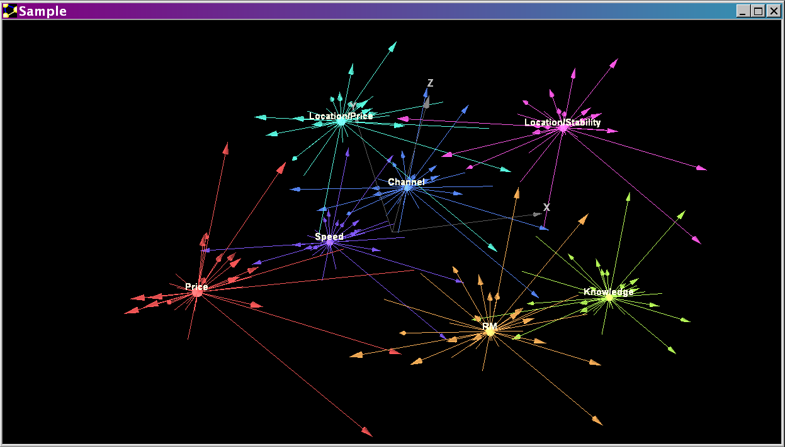
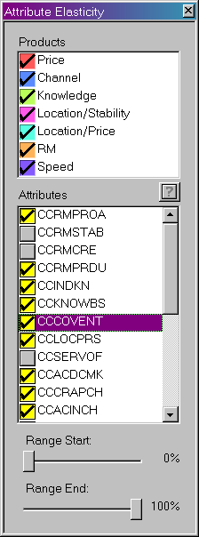
Attribute Elasticity
Attribute Elasticity: Theory and Practice
Attribute Elasticity
  Under the Inspect menu, select Attribute Elasticity, or select the icon above from the command center.
  Products: From the Attribute Elasticity dialog box, select one or more products to be entered into the analysis.
  Attributes: Select any combination of attributes that will be displayed on the map.
  Range: These two options determine the part of the elasticity lines that will be displayed. The Range Start percentage must be less than the Range End percentage. For example, if the data collected is on a one-to-ten scale, and Range Start and Range End are set to 20% and 90%, respectively, then PositionSolveTM will begin plotting the attribute elasticity line starting at 2 and ending at 9.
2
9
0 1 2 3 4 5 6 7 8 9 10

Slide 42
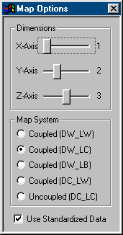
Map Options
Map Options
Use your pointing device to select Map Options from the command center dialog box.
Dimensions:
The total number of dimensions in the positioning map depend on the data. The maximum number on the dimensions slider will automatically be set to that number of dimensions.
Use the pointing device to change the sliders to display any of the dimensions desired.
Map System Applicability: MDA Only
Perceptual map elements can be mapped onto the screen in a number of ways.
By default, PositionSolveTM:
  Maps the products on the sum of their deviations from the grand mean on each attribute multiplied by the associated discriminant coefficient for that attribute multiplied by the associated discriminant coefficient for that attribute.
  Maps the attributes as vectors projecting from the center of the space. These vectors are the discriminant function coefficients.
In the decoupled method, these vectors are the correlations of the attributes with the discriminant functions. This is called the decoupled method, because the vectors (which are correlations) are plotted using a different method than the method used to plot the products. For general use, the default method should be used because it follows a standard plotting convention.
  The disadvantage of using a decoupled method arises when you want to execute the Simulate menu to see how changing an attribute (such as price) of a specific product moves that product on the map. With the decoupled method, changing a product on a specific attribute (such as price) will not necessarily move the product in a direction parallel to the arrow. Consequently, several coupled methods are available that move the product parallel to the arrow during simulation exercises.
See the appendix for more details about the Map System Options.

Slide 43
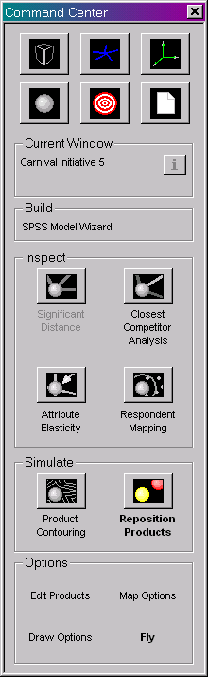
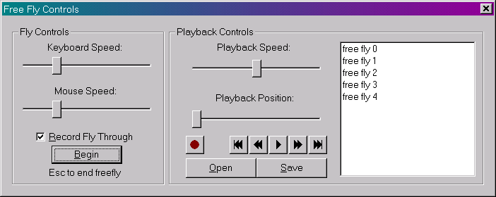
Fly Through
Fly Through
The Fly Through feature allows the user to inspect and maneuver through the map. This feature can also be used with any of the Inspect or Simulate options.
To open the Fly dialog box, select “Fly” from the Options section of the Command Center.
Select the “Begin” button to switch the map into free-fly mode. By default, all free-flies will be recorded, but will not be saved unless the user chooses a file name and location for the fly file.
To fly through the map, the user has two control options 1) a pointing device combined with the keyboard or 2 ) a joystick. At a minimum the joystick should be equipped with pitch, yaw and roll controls. Most users will find that a joystick gives superior control over fly-throughs.
Using the pointing device and keyboard: Your pointing device changes the perspective angle of the map, and the arrow keys change the position of the view. For example, imagine you are in an airplane, flying into a PositionSolveTM 3-D map. Moving your pointer changes which way the plane is facing, and the arrow keys determine whether the plane moves forwards, backwards, left, or right. So, by using the left arrow key and moving the pointer to the right to keep the map in view, it is possible to circle completely around the map at a constant distance from it.
Using a joystick: Pulling back/forward controls pitch (up and down), twisting left or right controls yaw (left or right) and tilting left or right controls roll (tipping your wings left or right to turn in that direction).
When a fly through session is being recorded, the Free Fly controls dialog and the command center will be hidden. Press the Escape key to stop the Fly Through and return to the dialog.
When a fly through has been recorded, it can be saved by selecting the file in the box on the right and clicking on the Save button. If there are previously recorded fly through files that do not appear in the box on the right, use the Open button to browse for the files.
To replay an existing fly through, select the file in the box on the right, and use the playback controls to play the fly through. The Playback position refers to the position in the fly through sequence.

Slide 44
Table of Contents
V. Market Niche Analysis (Product Contouring)
Theory
Practice

Slide 45
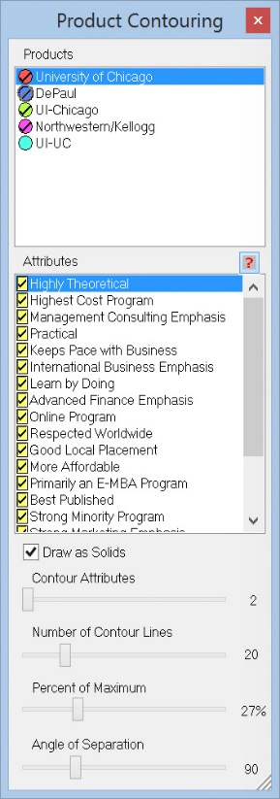
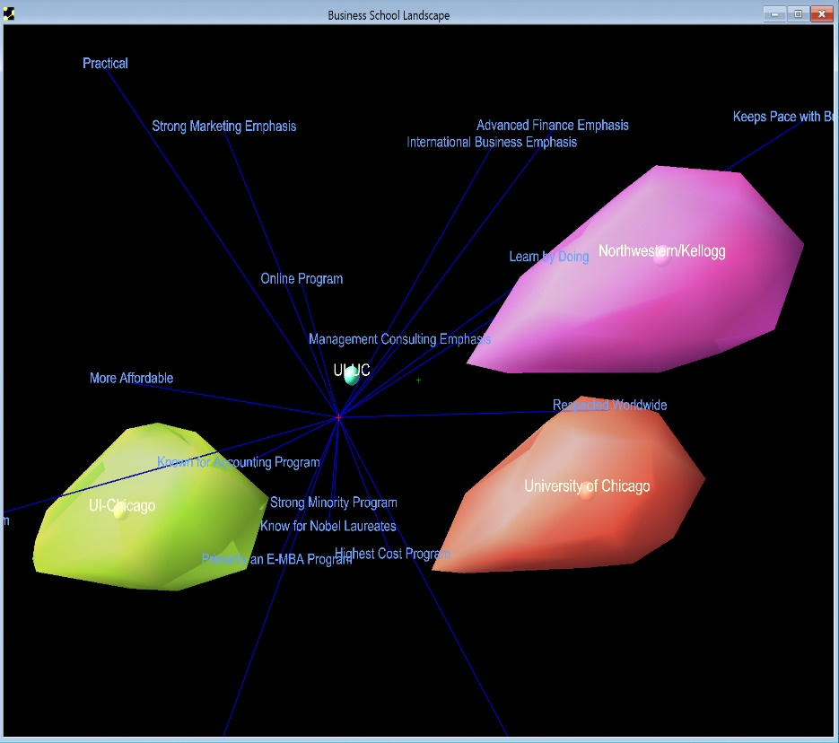
Market Niche Analysis (Product Contouring)
Market Niche Analysis: Theory
Applicability: MDA, CA and PCA
Why is Market Niche Analysis Useful?
  Market Niche Analysis (MNA) performs millions of simulations to discover the reasonable volume within which a competitor may move in the market. By doing so MNA determines the boundaries of a product’s movement in any direction, given the constraints set by the analyst.
  MNA can be used with Product Repositioning. Specifically, if the user sets the Percent Maximum in the Product Repositioning Dialog to 100% and the boundaries of two products do not intersect, no possible product repositioning strategies will be successfully allow either product to enter the other’s niche.
  How Does PositionSolveTM Contour Products?
  PositionSolveTM develops its contours by setting the attribute score to maximum on two or more attributes. This creates a point that is the vector sum of the attributes used. The algorithm then moves sequentially through all of the selected attributes, plotting their respective vector sums. A shape (technically a convex hull*) is then calculated to connect all of the points.
Interpreting Contour Maps
  In this example we switch to Business School competitor data.
  Products that do not overlap are competitively isolated from one another. Products that substantially overlap, on the other hand, are direct competitors.
  If one or more products are within your niche, the strategy may either be to advance or retreat from direct competition -- depending upon the perceived strength of the competitor.
  * = Convex hulls are commonly termed “shrink wrapping” algorithms because they wrap a solid around the points, This defines a volume within which a product can “move.”

Slide 46
Market Niche Analysis: Practice
Market Niche Analysis: Practice
Question:
  What are the attributes I can change about my product?
  If I change those attributes in all possible ways (small or large) how can I visualize my resulting niche in the competitive marketplace?
Input Data:
  Importance, performance data or pick-any data.
Steps:
  Open the data file
  Select a saved positioning map
  Open the product contouring dialog
  Set the contouring options
  Run the analysis
  Visualize the product contours
Results:
  Visualization of the market niche of all desired competitors

Slide 47

Example 1:
Market Niche Analysis: Practice
Open the Market Niche Analysis dialog
  Select Simulate, Contouring, or select the icon from the command center.
Select the Contouring Options
  When MNA is activated, the product contouring control panel appears.
  Select one or more products to be included in the niche/contour analysis.
  Select one or more attributes from the attributes box to be included in the analysis.
  The number of contour attributes selected with the slider determines the number of attributes whose magnitude is added together to determine one endpoint. All of the selected attributes will contribute to the contours.
  The number of contour lines does not alter the size or shape of the contours. This is used for visualization of the contours when the Draw as Solids checkbox is NOT selected.
  The Percent of Maximum slider controls what percent of the attribute vector is used to combine with other attribute vectors to define the endpoint. Thus, if, for instance, the Percent of Maximum slider is set to 27, then each attribute is set to 27% of the distance from the current setting of that attribute to the endpoint (maximum setting) for that attribute.
  The Angle of Separation refers to the number of degrees of angle beyond which attributes will not be combined together. Thus, if the angle of separation is 90 degrees then two attributes will not be combined together if the angle between them exceeds 90 degrees.

Slide 48
Table of Contents
IV. Product Repositioning
Theory
Practice

Slide 49
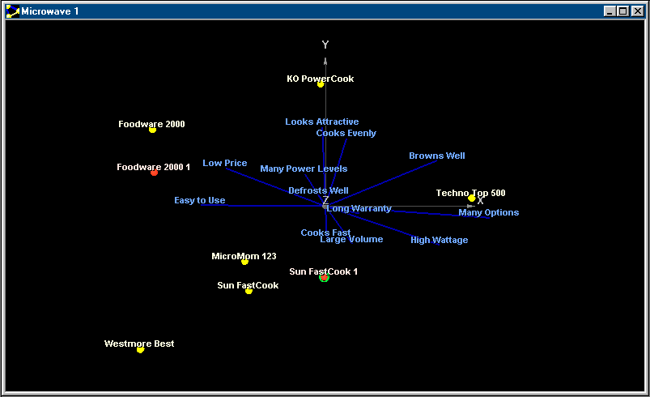
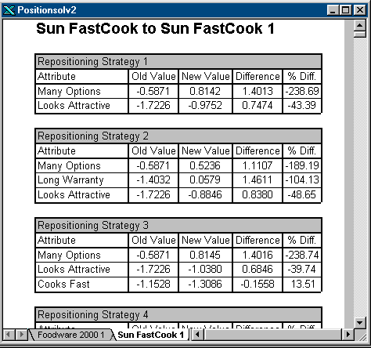
Product Repositioning: Theory
Product Repositioning: Theory
Why use product repositioning?
  Product Repositioning allows any given competitor to be dragged to a new position on the map, then the system tests all combinations of attributes that can move that competitor to that new position. PositionSolveTM then creates a report that lists all successful strategies. The user is then free to decide which of these equivalent strategies are the most actionable.
  An excellent strategy is to use Product Contouring to discover a competitor’s niche (the distance a product can move) and then use Product Repositioning to “get there”.
How does PositionSolveTM reposition products?
  Recall that each dimension is a linear combination of the attributes, so there are many possible solutions to arrive at any given position on the map. In addition (and as one would expect) there are generally more strategies possible when a product is closer to its original position. PositionSolveTM will not change an attribute beyond the maximum range for that attribute. Accordingly it is not possible to reposition a product to a location where it could not realistically move. In such a case, no strategies will be displayed for that product.

Slide 50
Example 2: Product Repositioning
Product Repositioning: Practice
Question:
  Which attributes do I need to change and by how much to arrive at a desired competitive position?
Input Data:
  Importance, performance or “pick any” data
Steps:
  Open a mapping data file (an SDT file)
  Select the positioning map desired
  Open the product repositioning dialog
  Create and position new products
  Set constraints and options
  Run the analysis
  View the results and evaluate strategies
Results:
  A report of specific attribute changes that will successfully move a product to the specified new positions on the positioning space

Slide 51
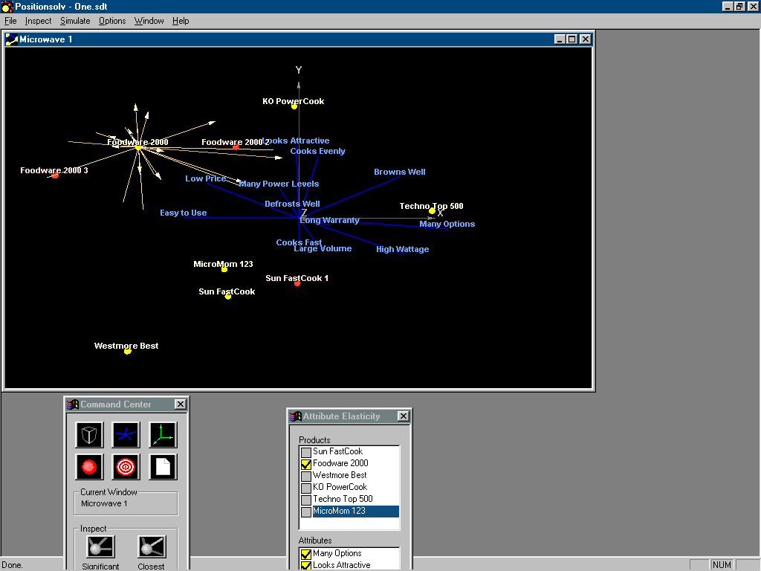
Example 2: Product Repositioning
Product Repositioning: Practice
Open Data File
  From the File menu, choose Open to select the mapping (SDT) file to open.
Open Product Repositioning dialog
  Select Simulate, Repositioning, or select the following icon from the control center.
Create and Position New Products
  A new probe product is created by clicking on a product sphere and dragging it to a new position (see the circled products on the dialog box.) This new product is based on the product it was created from (the boxed product), and hence its new position is calculated by changing its current attribute levels of that product.

Slide 52
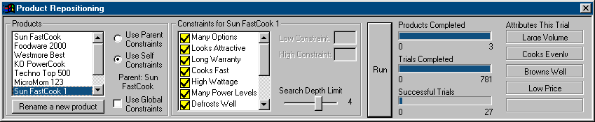
Product Repositioning (cont’d)
Product Repositioning: Practice
Set the Positioning Constraints
  The attributes listed in the product repositioning constraints dialog box (above) can apply to 1) only one product at a time or 2) apply to all products at a time (by using the global constraints box.)
  To select which attributes that can contribute to moving the product or products to their new postions, simply use your pointing device to select or deselect those attributes. At least one attribute must be selected to run the analysis.
  The Search Depth Limit slider determines the maximum number of attributes that can be combined together to arrive at the new positions you have defined for your products. For instance, if 15 attributes are selected and the search depth limit is 4, then the total number of strategies will be 15 attributes taken four at a time (1365), plus fifteen attributes taken 3 at a time (455), plus 15 attributes taken two at a time (105), plus fifteen attributes taken one at a time (15). Thus, if these are global constraints, 1940 combinations of attributes will be executed for each new product position.
Run Analysis
  Select the Run button, and the repositioning report will be generated.

Slide 53
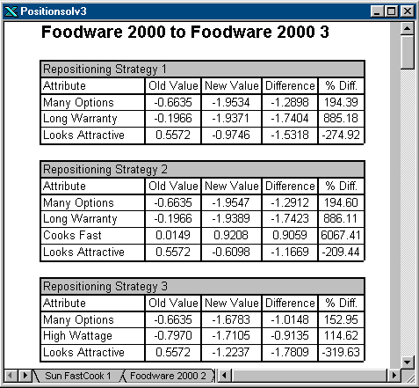
Product Repositioning
Product Repositioning: Practice
View Tables and Evaluate Strategies
  The reports for each new product are accessible by the tabs at the bottom of the report window. Each new product has a separate report.
  The Old and New values columns are expressed in either the units the data was collected in, or as Z-Scores (standard deviations from the mean of the attribute across all products.) To define which data is shown, see the checkbox on the prior page.
  The Difference column contains the absolute value of the arithmetic difference between the Old Value and the New Value.
  The % Diff. column values are a relative difference between the old and new values of the attributes. Accordingly, if the old or new value is close to zero (as it often may be when using Z-scores), the percent difference is significantly greater than if the value is closer to one.

Slide 54
V. Appendix - Reference Manual
A. Dialog Boxes
B. Using Charts/Graphs
C. Personalities

Slide 55
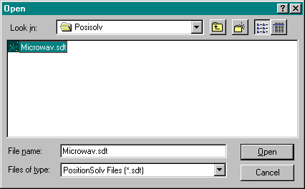
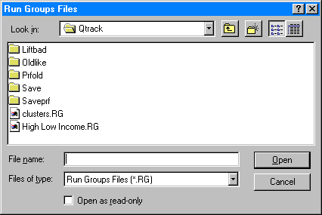
1. File: Open
Appendix A: Dialog Boxes
A mapping data file (a file with the extension .SDT) must be opened in PositionSolveTM to begin any desired analyses. PositionSolveTM creates an SDT file when the user finishes entering data in the Build wizard.
Use the Open icon or select Open from the File menu to get to the Open dialog box.
Browse through available directories using the button. Select the desired directory by clicking on it twice.
If the button is selected, PositionSolveTM will exit this dialog box and cancel any changes that were made.

Slide 56
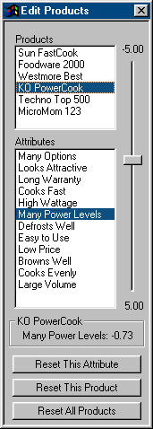
2. Using Edit Product to Perform Manual
Simulations:
Appendix A: Dialog Boxes
To perform simulations, click on Edit Products from the command center dialog box.
The PositionSolveTM embedded manual simulator allows you to change the position of competitors on the map by modifying specific attribute scores for each competitor. To provide immediate feedback, the product will automatically move on the map as the attribute score is changed.
Sumulations can only be performed for original products whose full set of attribute scores were contained in the data file.
To perform a manual simulation:
  Select one product and one attribute.
  Change the score on the attribute from its default value. Notice that the product name, the attribute name, and the attribute level are displayed in the box under the attributes.
  After an attribute value has been modified, the buttons at the bottom of the dialog box will be available. Use these reset buttons to return to the default settings for a specific attribute, product, or all products.

Slide 57
3. Map Options More Details
Appendix A: Dialog Boxes
Map System: Applicability: Only MDA
As mentioned in Section I: The advantages and disadvantages of each of the coupled methods are somewhat involved. The coupled methods are based on different algorithms that combine the standard means of plotting product (as the sum of attribute deviations multiplied by the discriminant function) with the fact that each attribute is differentially correlated with each function. In the selection box, the coupled methods are identified with acronyms based on the algorithm used to locate the products and attributes on the perceptual map.
Historically, the first coupled method (DW_LW) and the uncoupled method (DC_LC) have both been widely used. Outside of these two methods, the other coupled methods have not earned as wide a recognition.
DW_LW The products and attributes obtain their direction (D) and length (L) based on the discriminant canonical correlation coefficient or weight (W).
DW_LC The products and attributes obtain their direction (D) from the discriminant canonical correlation coefficient or weight (W) and the length (L) from the correlation of each attribute with the discriminant function (C).
DW_LB The products and attributes obtain their direction (D) from the discriminant canonical correlation coefficient or weight (W) and the length (L) from both the correlation of each attribute with the discriminant function and the discriminant function.
DC_LW The products and attributes obtain their direction (D) from the correlation of each attribute with the discriminant function (C) and their length (L) from the canonical correlation coefficient or weight (W).
DC_LC Refers only to the attributes. The attributes obtain their direction (D) from the correlation of each attribute with the discriminant function (C) and their length (L) from the correlation of each attribute with the discriminant function (C). The products obtain their direction (D) and length (L) based on the discriminant canonical correlation coefficient or weight (W). Because the method for locating the products is different from the attributes, this method is called decoupled.

Slide 58
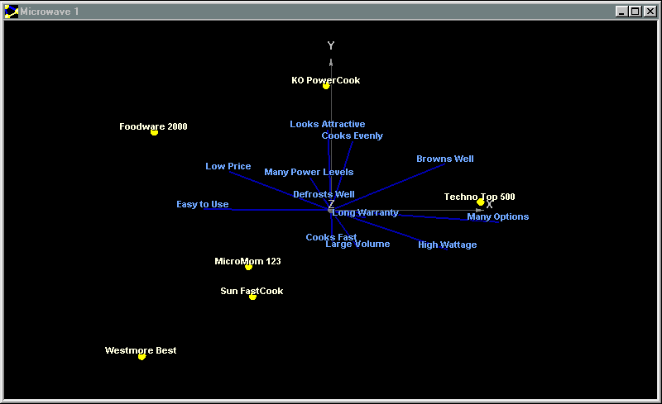

Appendix B: Using Charts: Movement
Appendix B
Rotation
There is powerful movement control over all charts created in PositionSolveTM. Move your pointer device (e.g. click the left button on your mouse and move it on the screen) or use the arrow keys to change the display of the chart. The labels and text will disappear while the chart is being moved, and the outline of the attribute vectors and the product positions will give a 3-D image of how how the chart will look.
A chart can be moved to change the angle of perspective on the perceptual map. Dragging your pointer vertically or using the up and down arrows will rotate the chart around a horizontal axis. Likewise, dragging your pointer horizontally or using the left and right arrows will rotate the chart around a vertical axis.
Zoom
Hold down the ‘Ctrl’ key, and drag your pointer upward to zoom up, or down to zoom down.
Placement
Hold down the Shift key, and drag your pointer to change where the map is centered.

Slide 59


Appendix C. Personalities
Appendix C
Personalities is the term used to describe map settings stored together. A personality file contains a map’s axis display settings, series draw settings, label settings, and many other settings that effect the appearance of a map. In order to save time, a personality can be created and applied to every new map created, or even to old maps.
Personalities
  Select the icon from the command center.
  Apply Default Personality: Apply the default personality to the open map.
  Load New Personality: Apply a personality, from a file, to the open map.
  Save New Personality: Save the current map’s settings to a personality file for later use.
  Enable Default Personality: When a wizard is executed, apply the default personality to the newly created map if this is checked.
  Change Default Personality: Choose a different personality file to be the default.

